Slide 1

6th Grade Math
Unit 4, Lesson 7 Comparing a Quantity and Its Opposite in Real-World Context Volume 1, pg. 168

Slide 2


Benchmark
MA.6.NSO.1.2
Given a mathematical or real-world context, represent quantities that have opposite direction using rational numbers. Compare them on a number line and explain the meaning of zero within its context.
volume 1, pg. 168

Slide 3
Integrated Mathematical Thinking and Reasoning Standards
MA.K12.MTR.2.1 Demonstrate understanding by representing problems in multiple ways.
MA.K12.MTR.7.1 Apply mathematics to real-world contexts.
volume 1, pg. 168

Slide 4

Learning Targets
I can compare a quantity and its opposite on a horizontal or vertical line and explain the meaning of zero within the context.
I can use the structure of a horizontal and vertical number line to plot rational numbers from a real-world context.
volume 1, pg. 168

Slide 5

Warm-Up
volume 1, pg. 168

Slide 6
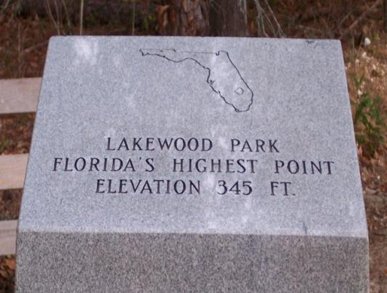
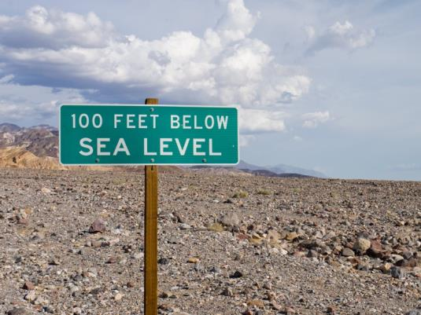
4.7.1 Warm-Up: Ordering Elevations
Four images from locations across the United States are shown.
Write an integer that represents each elevation.
a. Integer: ________ | b. Integer: ________
volume 1, pg. 168

Slide 7
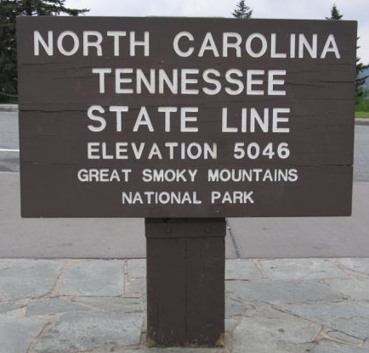
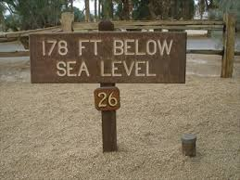
c. Integer: ________ | d. Integer: ________
Order the letter of the pictures from lowest elevation to highest.
_____ _____ _____ _____
volume 1, pg. 168

Slide 8

Collaboration
volume 1, pg. 169

Slide 9

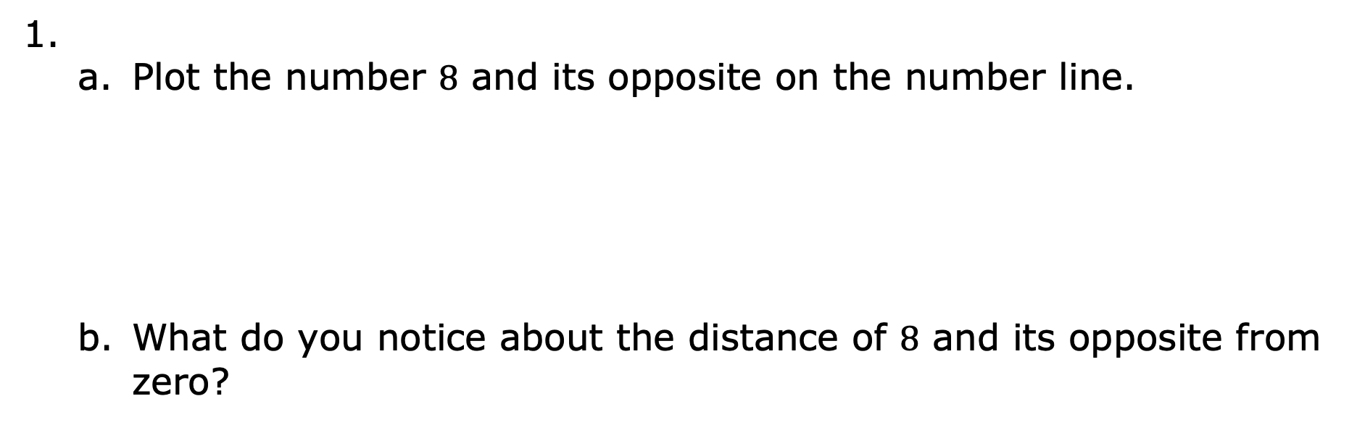
4.7.2 Collaboration: A Quantity and Its Opposite
Plot the number $8$ and its opposite on the number line.
What do you notice about the distance of $8$ and its opposite from zero?
volume 1, pg. 169

Slide 10
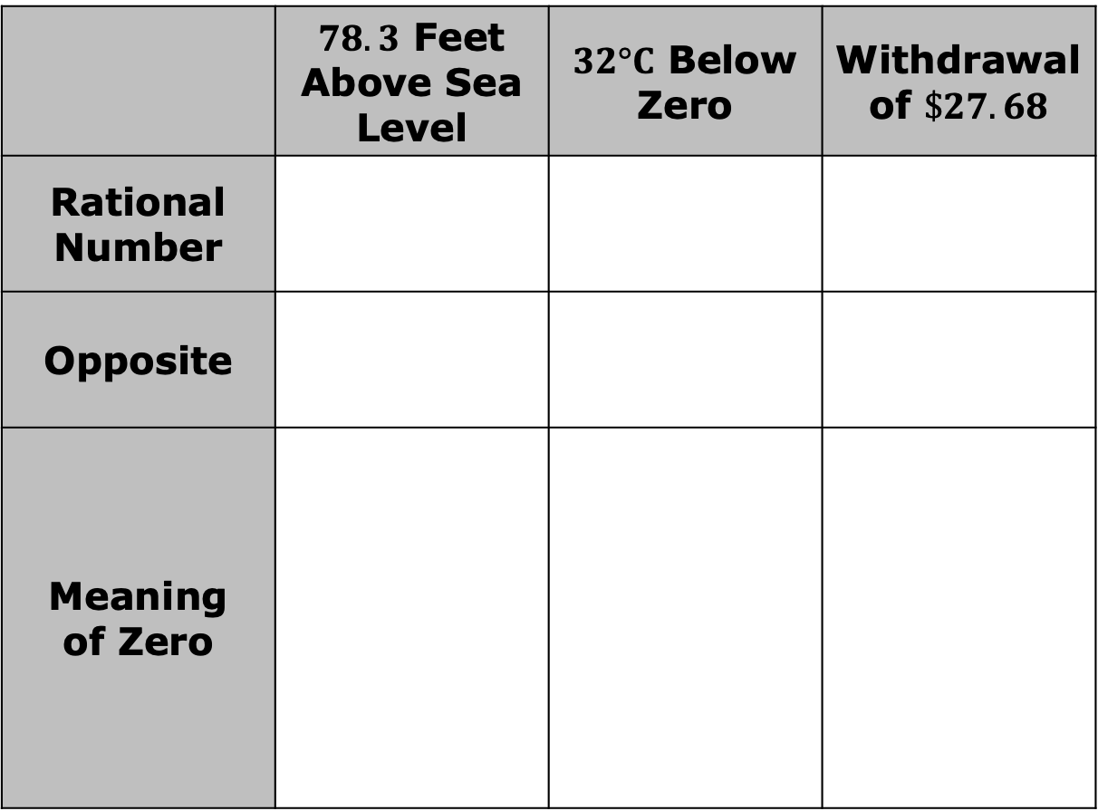
Complete the table for each situation given.
 | $78.3$ Feet Above Sea Level | $32°C$ Below Zero | Withdrawal of $\$27.68$
Rational Number
Opposite
Meaning of Zero
volume 1, pg. 169

Slide 11
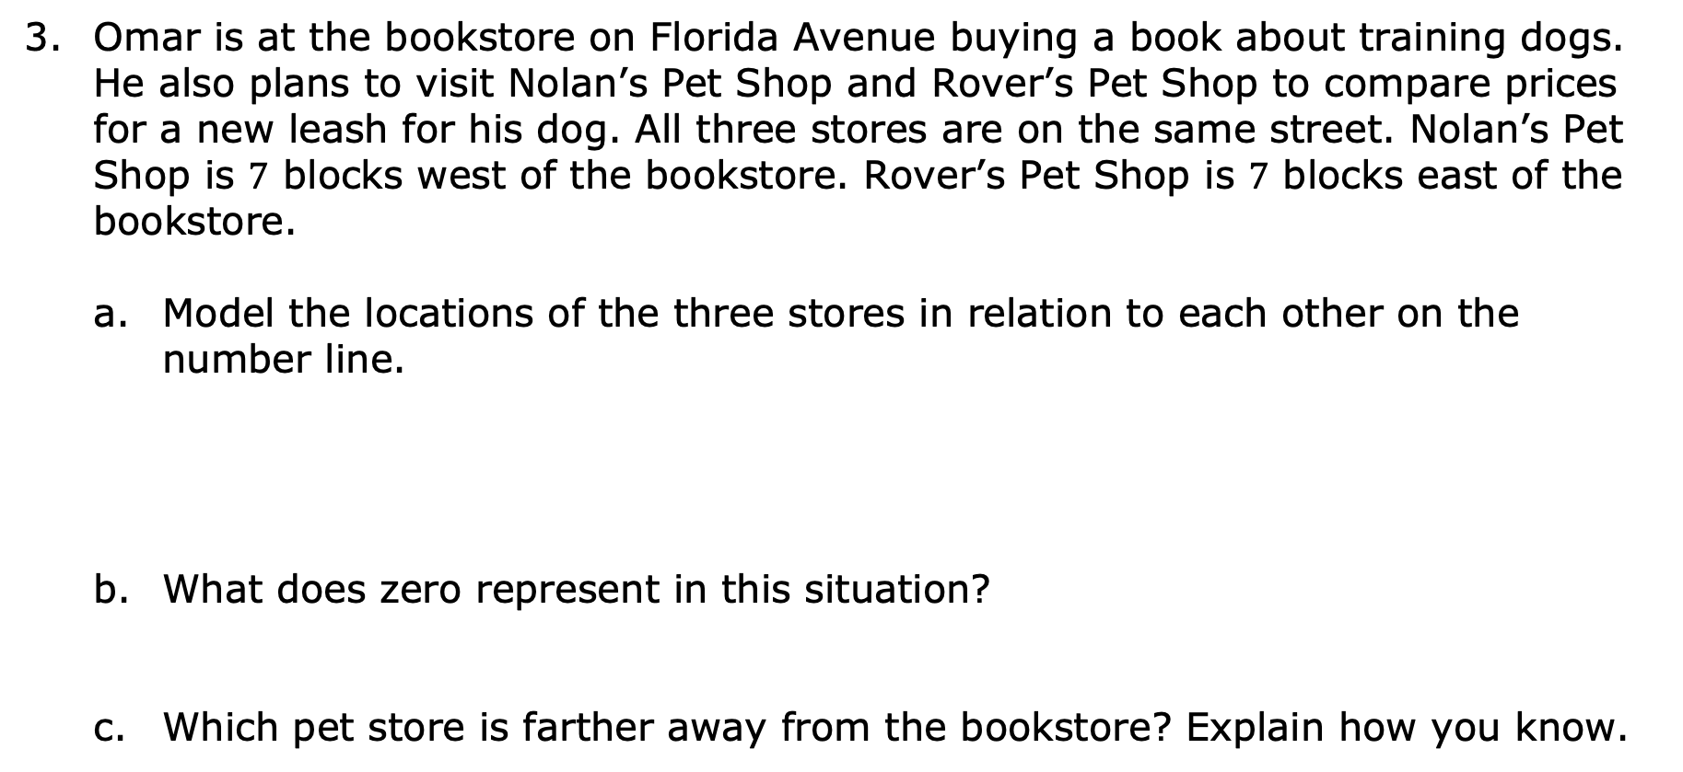
Omar is at the bookstore on Florida Avenue buying a book about training dogs. He also plans to visit Nolan’s Pet Shop and Rover’s Pet Shop to compare prices for a new leash for his dog. All three stores are on the same street. Nolan’s Pet Shop is $7$ blocks west of the bookstore. Rover’s Pet Shop is $7$ blocks east of the bookstore.
Model the locations of the three stores in relation to each other on the number line.
What does zero represent in this situation?
Which pet store is farther away from the bookstore? Explain how you know.
volume 1, pg. 170

Slide 12

Try It
volume 1, pg. 170

Slide 13

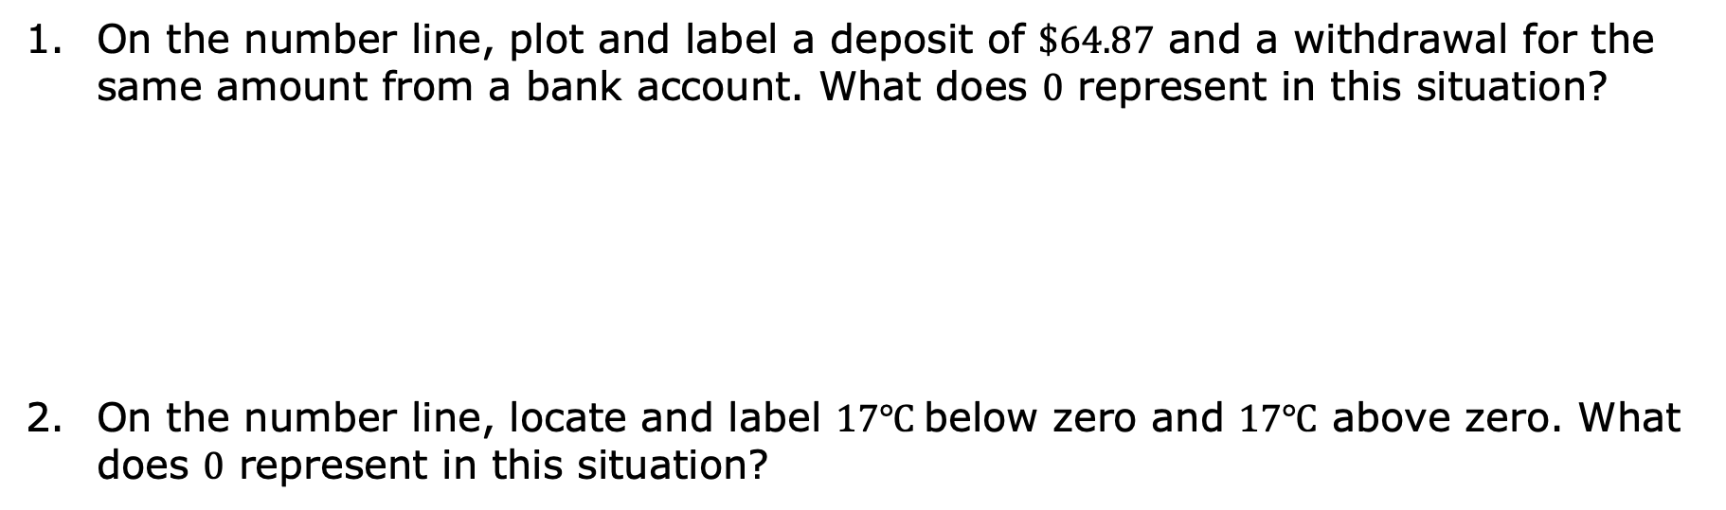
4.7.3 Try It: A Quantity and Its Opposite
On the number line, plot and label a deposit of $\$64.87$ and a withdrawal for the same amount from a bank account. What does $0$ represent in this situation?
On the number line, locate and label $17℃$below zero and $17℃$ above zero. What does $0$ represent in this situation?
volume 1, pg. 170

Slide 14
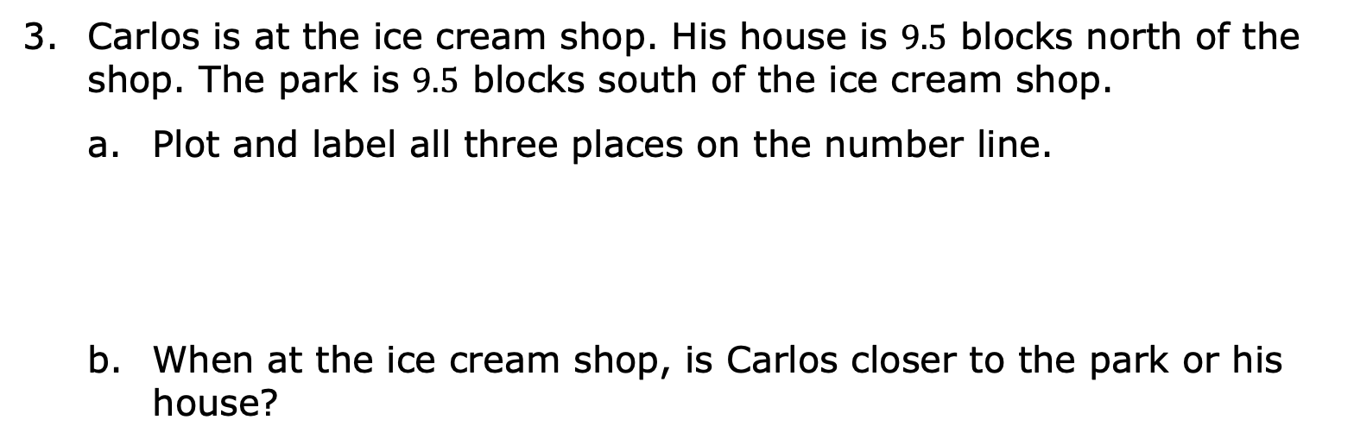
Carlos is at the ice cream shop. His house is $9.5$ blocks north of the shop. The park is $9.5$ blocks south of the ice cream shop.
Plot and label all three places on the number line.
When at the ice cream shop, is Carlos closer to the park or his house?
volume 1, pg. 171

Slide 15
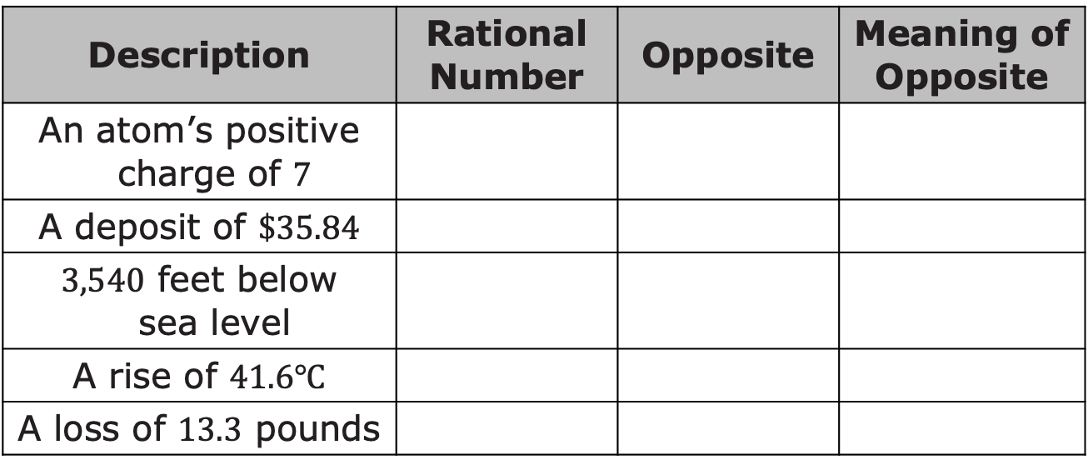

Write the rational number that represents the description, the rational number’s opposite, and the meaning of the opposite in context of the description.
With a partner, choose one description and describe what$0$ could represent in that situation.
Description | Rational Number | Opposite | Meaning of Opposite
An atom’s positive charge of $7$
A deposit of $\$35.84$
$3,540$ feet below sea level
A rise of $41.6℃$
A loss of $13.3$ pounds
volume 1, pg. 171

Slide 16

Bring It Together
volume 1, pg. 172

Slide 17

4.7.4 Bring It Together: A Quantity and Its Opposite
Work with a partner to write answers to the following questions.
What is the relationship between any number and its opposite when plotted on a number line?
How can you use this relationship to locate the opposite of a given number on the number line?
volume 1, pg. 172

Slide 18

Your Turn
volume 1, pg. 172

Slide 19
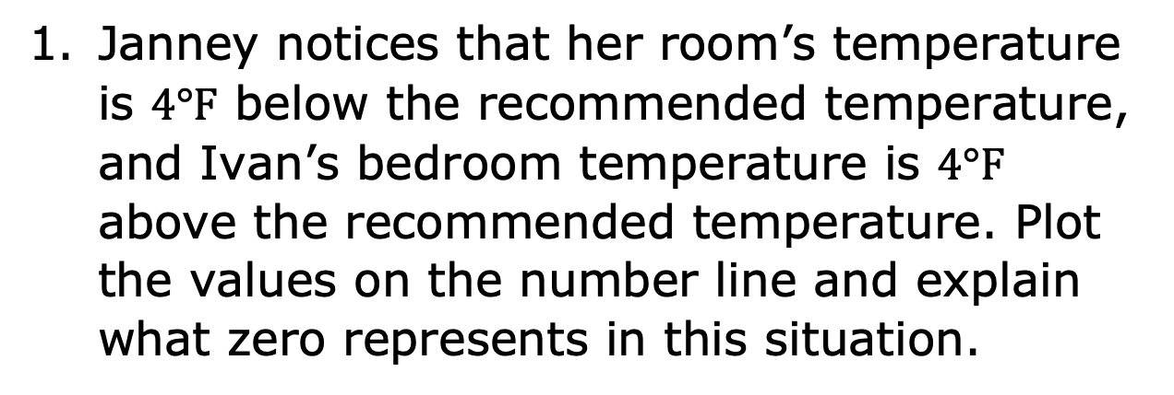
4.7.5 Your Turn!
Janney notices that her room’s temperature is $4°F$ below the recommended temperature, and Ivan’s bedroom temperature is $4°F$ above the recommended temperature. Plot the values on the number line and explain what zero represents in this situation.
volume 1, pg. 172

Slide 20
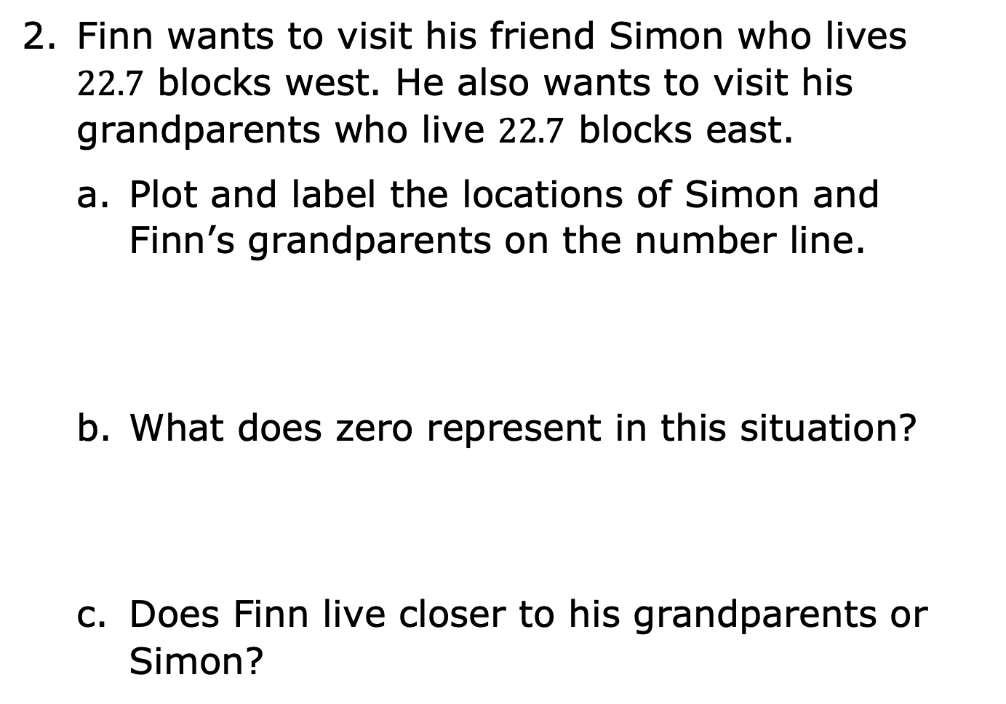
Finn wants to visit his friend Simon who lives $22.7$ blocks west. He also wants to visit his grandparents who live $22.7$ blocks east.
Plot and label the locations of Simon and Finn’s grandparents on the number line.
What does zero represent in this situation?
Does Finn live closer to his grandparents or Simon?
West East
volume 1, pg. 173

Slide 21

Wrap-Up
volume 1, pg. 173

Slide 22
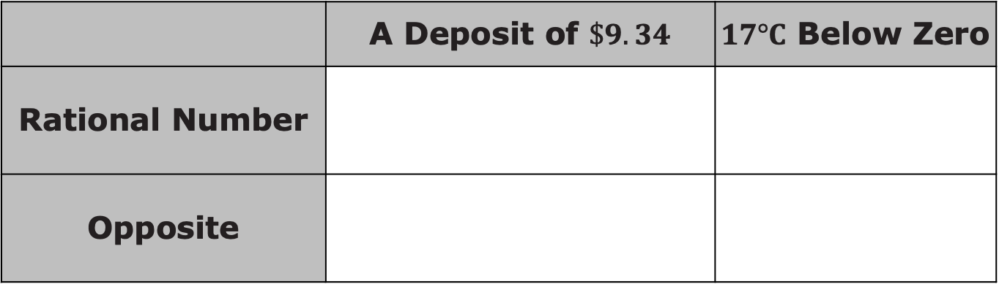
4.7.6 Wrap-Up: Ticket Out the Door
Complete the following in the table.
Write the rational number that represents the situation.
Write the opposite of the rational number.
Represent the rational number and its opposite on the number line with appropriate labels.
Explain the meaning of zero in the situation.
 | A Deposit of $\$9.34$ | $17°C$ Below Zero
Rational Number
Opposite
volume 1, pg. 173

Slide 23
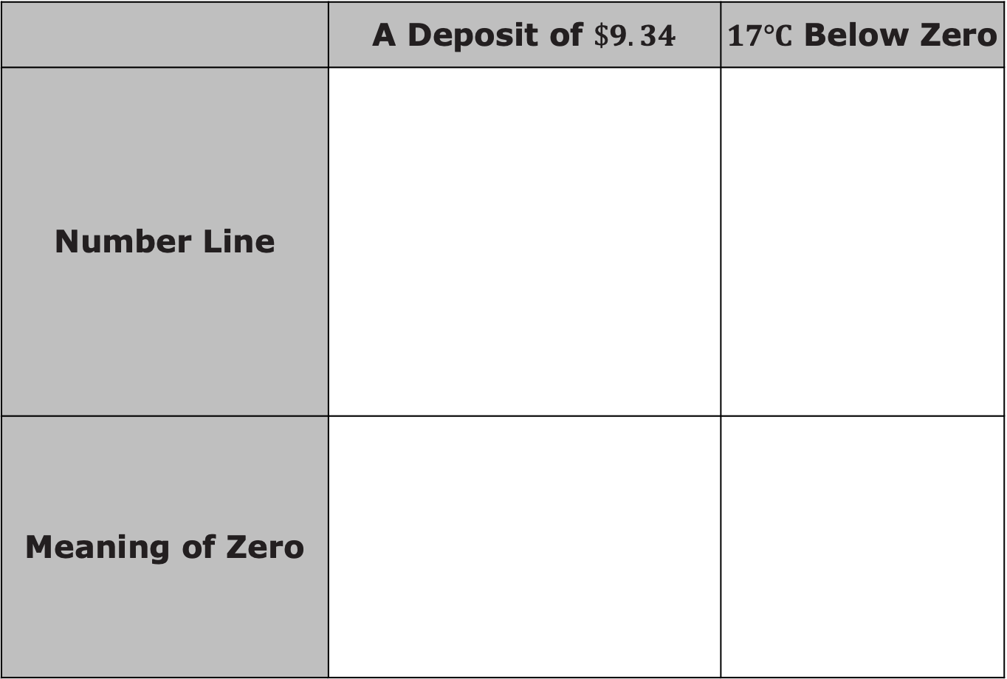
 | A Deposit of $\$9.34$ | $17°C$ Below Zero
Number Line
Meaning of Zero
volume 1, pg. 173

